Slide 1


World AIDS Day
2020
HIV in the UK

Slide 2


Overview
Key facts about HIV
What it’s like to live with HIV
What can you do?

Slide 3
What is World AIDS Day?
World AIDS Day is held every year on 1 December to raise awareness about HIV.
It is a day to show support for people living with HIV, remember those who have lost their lives because of HIV and learn the facts and realities of HIV today, in the UK and worldwide.

Slide 4
What is HIV?
HIV is a virus that attacks the body's immune system. It stands for Human Immunodeficiency Virus (HIV).
HIV is the not the same as AIDS.
AIDS stands for Acquired Immune Deficiency Syndrome and can develop when HIV damages the immune system to such an extent that it can no longer fight off a range of infections it would normally cope with.

Slide 5
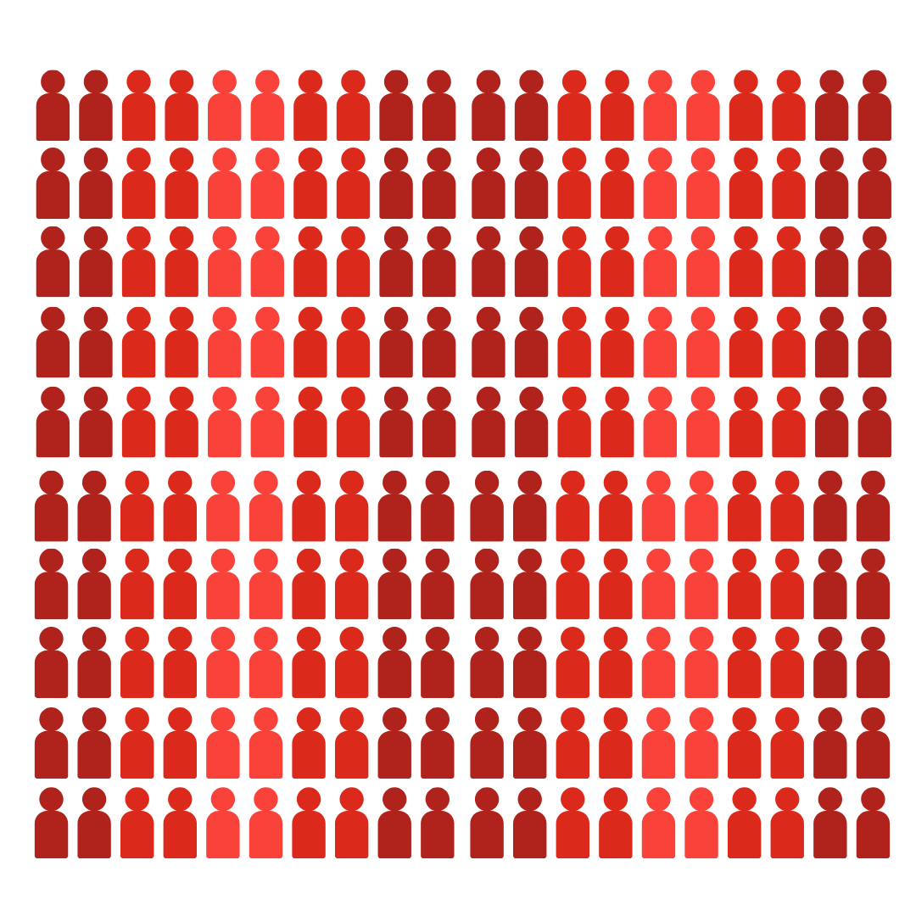
Globally, how many people are living with HIV?
38
million
Notes:
Q: How many people are living with HIV in the entire world?
A: In 2019, there were around 38 million people living with HIV globally. In some countries, people can struggle to access testing or treatment.

Slide 6

How many people are living with HIV in the UK?
103,800
Notes:
Q: How many people are living with HIV in the UK?
A: Around 103,800 people are living with HIV in the UK as of 2019.

Slide 7

Of everyone living with HIV in the UK, how many don’t know?
1 in 12
Notes:
Q: How many people are living with HIV in the UK but don’t know that they have it?
A: Of these, 1 in 12 people do not know they have HIV (or about eight per cent).

Slide 8
How is HIV passed on?
In the UK, the two main routes of getting HIV are:
Having sex without condoms or other forms of protection.
(Other forms of protection include PrEP, a drug a person can take to stop them from getting HIV, and HIV treatment. If a person living with HIV is on effective treatment, they can’t pass HIV on.)
2. Sharing needles and injecting equipment.
Notes:
Q: Does anyone know how HIV is passed on to other people?
A: In the UK, the two main routes of getting HIV is by:
1. Having sex without condoms or other form of protection. Other forms of protection include PrEP, a drug a person can take to stop them from getting HIV, and HIV treatment. If a person living with HIV is on effective treatment, they can’t pass HIV on.
2. Sharing needles and injecting equipment
Anyone can get HIV if they are exposed to HIV via these routes.
Elsewhere in the world, there is also a risk for pregnant women passing HIV on to their babies, but this doesn’t really happen in the UK because HIV treatment stops this from happening.
These are the only ways HIV can be passed on. There is no risk of passing on HIV through day-to-day contact, touching, kissing or any other way.
Top tip
Other examples of things you can’t get HIV from include biting, spitting, sharing cutlery, loo seats or sharing tooth brushes.

Slide 9



How to prevent HIV
U=U
Notes:
Q: What methods can be used to prevent HIV from being passed on?
A: To prevent HIV being passed on, the following methods can be used:
Condoms: Using condoms when having sex can prevent HIV from being passed on. Condoms have the additional benefit of preventing all other STIs and pregnancy too.
PEP and PrEP: PEP can be taken 48 hours after possible exposure to HIV, for example, if a person has had unprotected sex. It can be prescribed in sexual health clinics or in hospital. PrEP is a pill that is taken daily to prevent exposure to HIV. It is available on the NHS to those who are most at risk of HIV.
U=U: U=U means ‘Undetectable = Untransmissible’. When someone living with HIV is on good treatment, the amount of virus in the body is reduced to ‘undetectable’ levels and they can’t pass on HIV to their sexual partners.
Clean needles and other ways of reducing harms from injecting drug use: Clean needles and other equipment are distributed to people who inject drugs to prevent sharing of needles.
For more information on U=U, see http://i-base.info/htb/32308
Top tip
You might want to mention here where people can access free condoms in your local area. If you’re not sure, you can find this information at https://www.nhs.uk/service-search/other-services/Free-condoms/LocationSearch/732

Slide 10
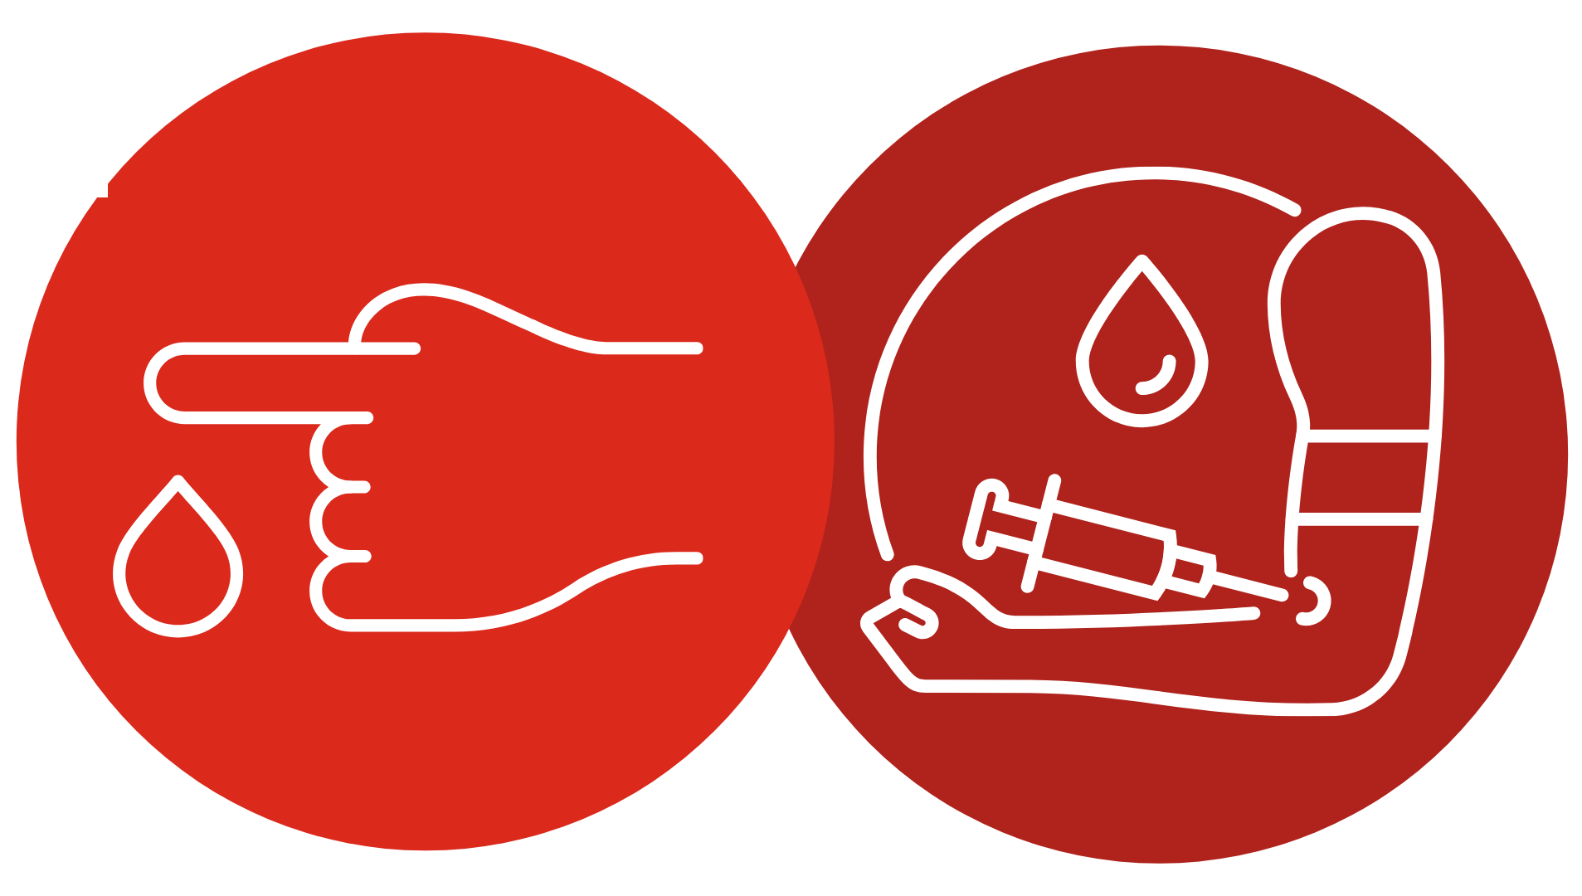
Getting tested for HIV
Notes:
People find out if they have HIV by getting tested for it. An HIV test is usually taken by a finger-prick test. You can get an HIV test at your doctor’s or at a sexual health clinic.
If you are having regular sex, it’s important to get tested regularly so you know your status. Do you remember the 1 in 12 people who don’t know they have HIV from the previous slide? This is a problem because if someone has HIV, the longer it’s left untreated the more ill they can become.
Top tip
You might want to mention here where people can go for an HIV test in your local area. You can find this information at https://www.nhs.uk/Service-Search/HIV-testing/LocationSearch/418

Slide 11

HIV treatment
Image source: Changing Perceptions
Notes:
It’s important that people diagnosed with HIV get treated for it. Although we don’t have a cure for HIV yet, treatment is so good that most people living with HIV only need to take one pill a day, and they can expect to live a long and healthy life if they’re diagnosed in good time. All the people in this picture are living with HIV – and they look pretty happy and healthy don’t they?
As I’ve already mentioned, the other benefit of treatment is that it suppresses HIV so that the person so they can’t pass it on to their sexual partners. 96% of people living with HIV who are on treatment in the UK can’t pass it on.

Slide 12
Living with HIV
HIV stigma
def. When people living with HIV are judged and treated badly because of prejudice and assumptions about HIV.
Notes:
Although we now have great treatment and people living with HIV can live long and healthy lives, they still experience HIV stigma.
When people living with HIV are judged and treated badly because of prejudice and assumptions about HIV, we call this ‘HIV stigma’.
Stigma persists because many people don’t understand the reality of HIV and are scared of it.
But people living with HIV deserve our respect and dignity, just like anyone else.

Slide 13

Living with HIV
Click above to watch the video or visit: https://youtu.be/r88CC8UTrOI
Notes:
NOTE FOR SPEAKER: this 5-minute video sees three people living with HIV in the UK tell their story.

Slide 14
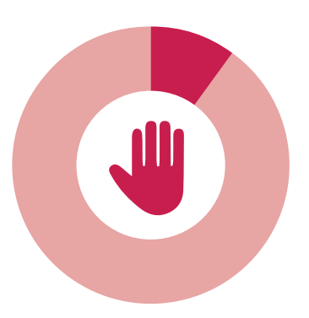
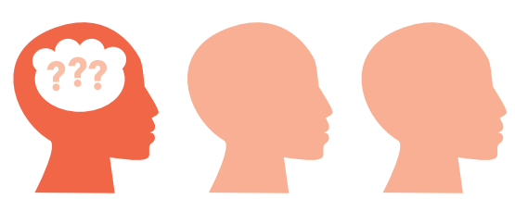
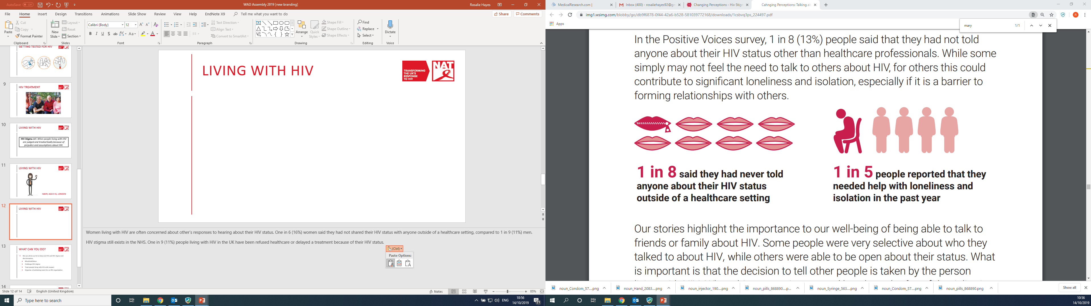
Living with HIV
1 in 8
said they had never told anyone about their HIV status other than healthcare professionals.
1 in 5 people needed help with loneliness and isolation in the past year.
1 in 10
had been denied or refused a health treatment or procedure that they needed.
1 in 3
worried that they would be treated differently to other patients.
Image source: Changing Perceptions
Notes:
People living with HIV are often concerned about other’s responses to hearing about their HIV status.
In 2018, 1 in 8 people living with HIV said they had not shared their HIV status with anyone other than healthcare professionals. While some simply may not feel the need to talk to others about HIV, for others this could contribute to significant loneliness and isolation, especially if it is a barrier to forming relationships with others. 1 in 5 people living with HIV said that they needed help with loneliness and isolation in the past year.
Even in the NHS, HIV stigma still exists. One in 10 people living with HIV in the UK have been refused healthcare or delayed a treatment because of their HIV status. One in 3 people living with HIV have been worried that they would be treated differently to other patients.

Slide 15

What can you do?
#RockTheRibbon
Challenge HIV stigma.
Treat people living with HIV with respect.
Organise a fundraiser for an HIV organisation.
Notes:
We can all do our bit to tackle HIV stigma and support people living with HIV.
#RocktheRibbon
The 2020 World AIDS Day campaign is ‘Rock the Ribbon’. We are encouraging everybody to wear their red ribbon with pride, show support for people living with HIV and help us end HIV in the UK for good by getting HIV transmissions to zero and fighting stigma.
Top tip
If you order ribbons from us in advance, you could ask people if they would like to donate for a ribbon as they leave the presentation or during their lunch break. You can order red ribbons for free here.
Challenge HIV stigma
You can also challenge HIV stigma with the key facts you’ve learned today. If you hear someone saying stigmatising things about HIV, challenge them yourselves or tell them where to find more information about HIV. Tell your friends and community about this presentation and what you have learned. You can learn more HIV facts at www.nat.org.uk
Treat people living with HIV with respect
If someone tells you they have HIV, don’t tell anyone else without their permission. Be supportive, respect their confidentiality and treat them like you would treat anyone else.
Organise a fundraiser for an HIV organisation
Organise an event at your office or in your community to raise much-needed funds for HIV organisations in your local area or national organisations like NAT. We’ve got a list of great ideas for fundraising events in our fundraising pack at http://www.worldaidsday.org/fundraising See www.worldaidsday.org for more information.

Slide 16
Summary
HIV is a virus that attacks the body’s immune system. It is not the same as AIDS.
With effective medication, people living with HIV can’t pass on the virus and can live as long as anyone else.
HIV stigma can make life difficult for people living with HIV.
You can support World AIDS Day 2020 by wearing a red ribbon, keeping yourself and others informed about HIV and treating people living with HIV with respect.
Notes:
These are the key messages we would like people to take away from this presentation.
• HIV is a virus that attacks the body’s immune system. It is not the same as AIDS.
• With effective medication, people living with HIV can’t pass on the virus and can live as long as anyone else.
• HIV stigma can make life difficult for people living with HIV.
• You can support World AIDS day by wearing a red ribbon, keeping yourself and others informed about HIV and treating people living with HIV with respect.

Slide 17

We’re the UK’s HIV rights charity. We work to stop HIV from standing in the way of health, dignity and equality, and to end new HIV transmissions. Our expertise, research and advocacy secure lasting change to the lives of people living with and at risk of HIV.
www.nat.org.uk

