Slide 1


WORLD AIDS DAY
HIV IN THE UK
World AIDS Day is celebrated annually on 1st December
Created by NAT (National AIDS Trust)
Supported by Owen Mumford

Slide 2
OVERVIEW
Key facts about HIV
What it’s like to live with HIV
What can you do?

Slide 3
WHAT IS WORLD AIDS DAY?
World AIDS Day (WAD) is held every year on 1st December to raise awareness about HIV.
It is a day to show support for people living with HIV, remember those who have lost their lives because of HIV and learn the facts and realities of HIV today, in the UK and worldwide.

Slide 4
WHAT IS HIV?
HIV is a virus that attacks the body's immune system. It stands for Human Immunodeficiency Virus (HIV).
HIV is the not the same as AIDS.
AIDS stands for Acquired Immune Deficiency Syndrome and can develop when HIV damages the immune system to such an extent that it can no longer fight off a range of infections it would normally cope with.

Slide 5

HOW MANY PEOPLE ARE LIVING WITH HIV GLOBALLY?
37.9 million
Notes:
Q: How many people are living with HIV in the entire world?
A: In 2018, there are around 37.9 million people living with HIV globally. In some countries, people can struggle to access testing or treatment.

Slide 6

HOW MANY PEOPLE ARE LIVING WITH HIV IN THE UK?
101,600
Notes:
Q: How many people are living with HIV in the UK?
A: Around 101,600 people are living with HIV in the UK.

Slide 7



HOW MANY PEOPLE ARE LIVING WITH HIV IN THE UK BUT DON’T KNOW THEY HAVE IT?
1 in 12
Notes:
Q: How many people are living with HIV in the UK but don’t know that they have it?
A: Of these, 1 in 12 people do not know they have HIV.

Slide 8

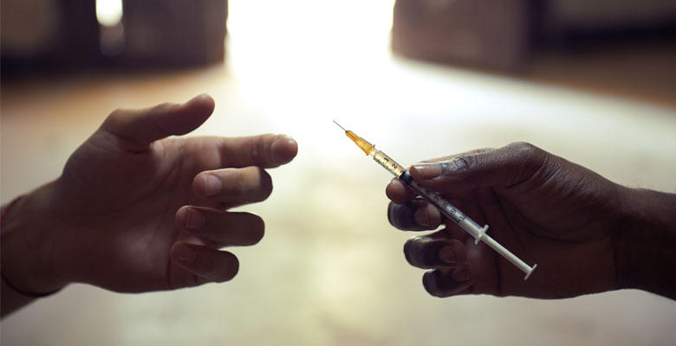
HOW HIV IS PASSED ON
Image source: Avert
Notes:
Q: Does anyone know how HIV is passed on to other people?
A: In the UK, the two main routes of getting HIV is by:
Having sex without condoms
Sharing needles and injecting equipment
Anyone can get HIV if they are exposed to HIV via these routes.
Elsewhere in the world, there is also a risk for pregnant women passing HIV on to their babies, but this doesn’t really happen in the UK because HIV treatment stops this from happening.
These are the only ways HIV can be passed on. There is no risk of passing on HIV through day-to-day contact, touching, kissing or any other way.
Top tip
Other examples of things you can’t get HIV from include biting, spitting, sharing cutlery, loo seats or sharing tooth brushes.

Slide 9



HOW TO PREVENT HIV
U=U
Notes:
Q: What methods can be used to prevent HIV from being passed on?
A: To prevent HIV being passed on, the following methods can be used:
Condoms: Using condoms when having sex can prevent HIV from being passed on. Condoms have the additional benefit of preventing all other STIs and pregnancy too
PEP and PrEP: PEP can be taken 48 hours after exposure to HIV, for example, when doctors have accidentally stabbed themselves with a needle used on a patient, or in the case of sexual assault. It is prescribed by a GP or in hospital. PrEP is a pill that is taken daily to prevent exposure to HIV. It is not yet routinely available on the NHS – but it is available through a clinical trial.
U=U: U=U means ‘Undetectable = Untransmissible’. When someone living with HIV is on treatment and has an undetectable viral load, they can’t pass on HIV to their sexual partners.
Clean needles: Clean needles are distributed to people who inject drugs to prevent sharing of needles.
For more information on U=U, see http://i-base.info/htb/32308
Top tip
You might want to mention here where students can access free condoms in your local area (e.g. available from the school nurse, young people’s sexual health clinic, etc.) If you’re not sure, you can find this information at https://www.nhs.uk/service-search/Sexual-health-services-for-young-people/LocationSearch/735

Slide 10
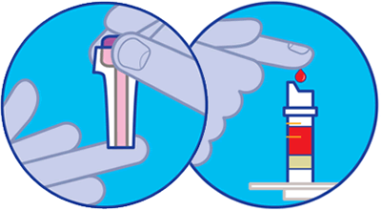
GETTING TESTED FOR HIV
Image source: Terrence Higgins Trust
Notes:
People find out if they have HIV by getting tested for it. An HIV test is usually taken by a finger-prick test. You can get an HIV test at your doctor’s or at a sexual health clinic.
If you start having sex, it’s important to get tested regularly so you know your status. Do you remember the 1 in 12 people who don’t know they have HIV from the previous slide? This is a problem because if someone has HIV, the longer it’s left untreated the more ill they can become.
Top tip
You might want to mention here where students can go for an HIV test in your local area. You can find this information at https://www.nhs.uk/Service-Search/HIV-testing/LocationSearch/418

Slide 11

HIV TREATMENT
Image source: Changing Perceptions
Notes:
It’s important that people diagnosed with HIV get treated for it. Although we don’t have a cure for HIV yet, treatment is so good that most people living with HIV only need to take one pill a day, and they can expect to live a long and healthy life if they’re diagnosed in good time. All the people in this picture are living with HIV – and they look pretty happy and healthy don’t they?
As I’ve already mentioned, the other benefit of treatment is that it suppresses HIV so that the person so they can’t pass it on to their sexual partners. 96% of people living with HIV who are on treatment in the UK can’t pass it on.

Slide 12
LIVING WITH HIV
HIV Stigma def. When people living with HIV are judged and treated badly because of prejudice and assumptions about HIV.
Notes:
Although we now have great treatment and people living with HIV can live long and healthy lives, they still experience HIV stigma.
When people living with HIV are judged and treated badly because of prejudice and assumptions about HIV, we call this ‘HIV stigma’.
Stigma persists because many people don’t understand the reality of HIV and are scared of it.
But people living with HIV deserve our respect and dignity, just like anyone else.

Slide 13
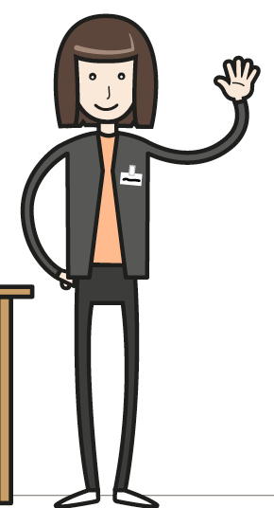
LIVING WITH HIV
MARY, AGED 45, LONDON
“My friends were such a source of support for me during this hard time…”
“I stopped looking for a relationship because I feared the stigma and discrimination I would face…”
“…he still wanted me regardless of my status”
“I never told any member of my family and I don’t intend to in the near future…”
Notes:
This is Mary. She is 45 years old and lives in London. This is Mary’s story:
“I discovered I was positive when I went for a routine test at a charity I wanted to volunteer for. I was devastated. I had the courage to call two friends of mine and one told me she herself was positive. My friends were such a source of support for me during this hard time; another took me for a confirmation test and helped me register with an HIV clinic, all along offering kindness and support.
After my diagnosis, I stopped looking for a relationship because I feared the stigma and discrimination I would face. After about 6 years, I went to a party and met a nice guy that I fancied. I was torn between letting him go or letting him know.
I sent him a message informing him about my status – at first, he thought I was lying. But once I told him it was true, he told me he still wanted me regardless of my status and we dated for over 5 years. I was undetectable for the entire time we were together and was taught at the clinic that there is not risk of HIV transmission if I am undetectable (U=U). He knew that I had an undetectable viral load and never showed any fear of getting infected. Even though we are no longer dating, he has always been supportive.
After we separated, I met another guy, but sadly my HIV status was not as well received this time. This new guy and I were never intimate, we never even kissed or held hands, yet when I told him about my status, he was furious I didn’t tell him sooner and he never contacted me again. I never told any member of my family and I don’t intend to in the near future, not because they will discriminate or stigmatise me, but because they will feel sorry for me and think I will die soon. People are still living in the dark about HIV and don’t realise that people living with HIV can live a happy and healthy life.

Slide 14
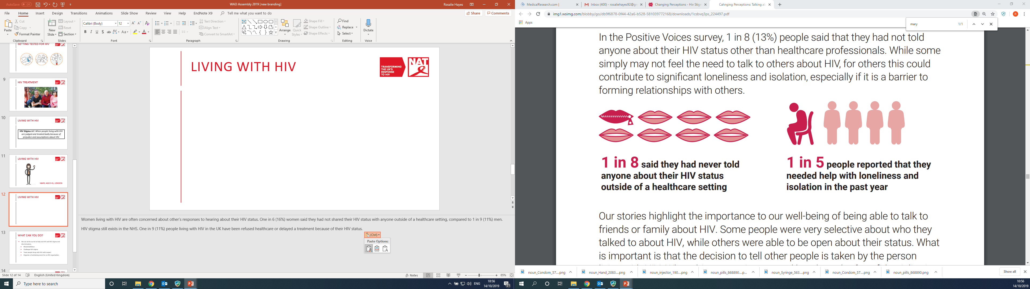
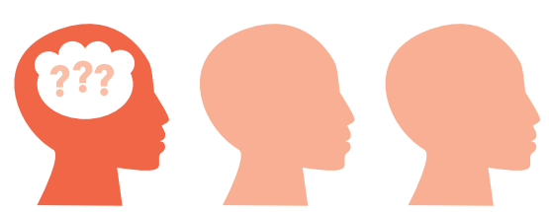
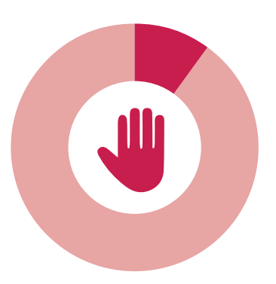
LIVING WITH HIV
1 in 8 said they had never told anyone about their HIV status other than healthcare professionals
1 in 3 worried that they would be treated differently to other patients
1 in 5 people needed help with loneliness and isolation in the past year
1 in 10 had actually been denied or refused a health treatment or procedure that they needed
Image source: Changing Perceptions
Notes:
People living with HIV are often concerned about other’s responses to hearing about their HIV status.
In 2018, 1 in 8 people living with HIV said they had not shared their HIV status with anyone other than healthcare professionals. While some simply may not feel the need to talk to others about HIV, for others this could contribute to significant loneliness and isolation, especially if it is a barrier to forming relationships with others. 1 in 5 people living with HIV said that they needed help with loneliness and isolation in the past year.
Even in the NHS, HIV stigma still exists. One in 3 people living with HIV have been worried that they would be treated differently to other patients. One in 10 people living with HIV in the UK have been refused healthcare or delayed a treatment because of their HIV status.

Slide 15

WHAT CAN YOU DO?
#RocktheRibbon
Challenge HIV stigma
Treat people living with HIV with respect
Organise a fundraiser for an HIV organisation
Notes:
We can all do our bit to tackle HIV stigma and support people living with HIV.
#RocktheRibbon
The 2019 World AIDS Day campaign is ‘Rock the Ribbon Together’. We are encouraging everybody to wear their red ribbon with pride, show support for people living with HIV and tackle the life-changing stigma and discrimination that people can face.
Top tip
If you order ribbons from us in advance, you could ask students if they would like to purchase a ribbon as they leave the assembly or during their lunch break. You can order red ribbons for free here.
Challenge HIV stigma
You can also challenge HIV stigma with the key facts you’ve learned today. If you hear someone saying stigmatising things about HIV, challenge them yourselves or tell an adult. Tell your friends and parents about this assembly and what you have learned. You can learn more HIV facts at www.nat.org.uk
Treat people living with HIV with respect
If someone tells you they have HIV, don’t tell anyone else without their permission. Be supportive, respect their confidentiality and treat them like you would treat anyone else.
Organise a fundraiser for an HIV organisation
Organise an event at your school or in your community to raise much-needed funds for HIV organisations in your local area or national organisations like NAT. We’ve got a list of great ideas for fundraising events at http://www.worldaidsday.org/fundraising See www.worldaidsday.org for more information.

Slide 16
SUMMARY
HIV is a virus that attacks the body’s immune system. It is not the same as AIDS.
With effective medication, people living with HIV can’t pass on the virus and can live as long as anyone else.
HIV stigma can make life difficult for people living with HIV.
You can support World AIDS day by wearing a red ribbon, keeping yourself and others informed about HIV and treating people living with HIV with respect.
Notes:
These are the key messages we would like students to take away from this assembly.
HIV is a virus that attacks the body’s immune system. It is not the same as AIDS.
With effective medication, people living with HIV can’t pass on the virus and can live as long as anyone else.
HIV stigma can make life difficult for people living with HIV.
You can support World AIDS day by wearing a red ribbon, keeping yourself and others informed about HIV and treating people living with HIV with respect.

Slide 17



WORLD AIDS DAY 2019
NAT (National AIDS Trust)
@NAT_AIDS Trust
nationalaidstrust

